Slide 1
Federal Research Center «Computer Science and Control»
of the Russian Academy of Sciences
Cross-language text alignment for plagiarism detection based on contextual and context-free models
Zubarev D.V.
Sochenkov I.V.
Moscow 2019

Slide 2
Cross-language plagiarism detection task
Source retrieval
given: a suspicious document and a large collection of sources
the task is to retrieve all plagiarized sources while minimizing retrieval costs
Text alignment
given: a pair of documents
the task is to identify all contiguous maximal-length passages of reused text between them

Slide 3
Cross-language text alignment
Text alignment methods usually use pairwise matching of sentences:
Each sentence from the document is compared with all sentences from the source text, producing M×N pairs
The task is to identify pairs that are plagiarized (classification task)
Postprocessing
Merge adjacent sentences into fragments
Merge fragments by some heuristics

Slide 4
Cross-language plagiarism detection methods
Cross-Language Character N-Gram (Potthast et al. 2011)
Machine translation approach: use a monolingual comparison between translated sentences (Barŕon-Cedẽno, 2012)
Cross-language similarity detection based on the word embeddings (Ferrero et al., 2017; Kutuzov et al., 2016)
Competitions
Translated plagiarism cases were used in PAN 2011 competition as one of an obfuscation type (without Russian)
SemEval 2017 had cross-lingual semantic textual similarity (STS) (without Russian)

Slide 5
Training cross-language word embeddings
Russian-English parallel sentences
United Nations (opus.nlpl.eu)
ParaCrawl (opus.nlpl.eu)
Wiki (opus.nlpl.eu)
OpenSubtitles (opus.nlpl.eu)
Yandex parallel corpus

Slide 6
Text Preprocessing
Tokenization and lemmatization (Aot)
Stop-words removal (conjunction, pronoun, etc.), and common words (be, the, a)
Some concepts from Wikidata (open knowledge base) are treated as single “word”:
martial_law, военное_положение, Организация_объединенных_наций
Result: pairs of parallel sentences, represented as sequences of lemmas

Slide 7
Training corpus statistics
51 million sentences
Dictionary size: 507k unique words/phrases (more than 10 occurrences in the corpus)
2 word phrases – 67k
3 word phrases – 11k
4 word phrases – 2k

Slide 8
Training embeddings
Learning cross-lingual word embedding mapping
Using vecmap framework (Artetxe et al. 2018)
Supervised with dictionary ~20k word pairs
Unsupervised
Training word2vec model on bilingual corpus (Vulić et al. 2015)
Select pairs of sentences that differ in length by less than 5 words (44M sentences left)
Interleave two parallel sentences, e.g.
"Мама мыла раму" + "Mother washed the frame“ =
"мама mother мыла washed раму the frame".

Slide 9
Evaluation of cross-language word embeddings
Word translation task
Gold dataset: Russian-English dictionary from Muse project (12k pairs)
Retrieve top 10 most similar words for a given word

Slide 10
Evaluation results
Model | Window size | Dim | Micro Recall | Precision at 1
biling-fasttext-skipgram | 5 | 300 | 86.35 | 69.36
biling-fasttext-skipgram | 10 | 300 | 86.05 | 69.61
biling-word2vec-skipgram | 10 | 300 | 84.69 | 70.87
biling-word2vec-skipgram | 5 | 300 | 83.48 | 69.83
vecmap-word2vec-supervised | 5 | 300 | 71.61 | 58.46
vecmap-word2vec-unsupervised | 5 | 300 | 70.36 | 57.48

Slide 11
Simple sentence similarities (1)
Sentence embeddings similarity
Sentence embeddings = averaged word embeddings
Cosine similarity between two sentence vectors
Words substitution
Substitute Russian words with N=3 most similar English words
Calculate score based on count of matching words and their similarity
$NSubst(S_{r},S_{e})=\sum_{w∈S_{e}}{\frac{\sum_{w_{r}∈M(w)}{Sim(w,w_{r})⋅(υ(w)+υ(w_{r}))}}{|M(w)|}}$, where
M(w_{e}) = {w_{r} | w_{r} ∈ S_{r} ∧ w_{e} ∈ Top(w_{r}, 'en')} is a set of Russian words that have $w_{e}$ in their top of similar words; $υ(w)$ is the number of words in a phrase if $w$ is a phrase and 1 otherwise

Slide 12
Simple sentence similarities (2)
Neural machine translation
Train machine translator (OpenNMT-py v0.5) on a subset of parallel sentences corpus (7M of parallel sentences)
Similarity measures
Jaccard similarity of translated and English sentences (NMT1)
Jaccard similarity calculated on word 2-grams (NMT2)

Slide 13
Classification
Binary classification of a pair of sentences
Classifier: Logistic Regression
LR-1
Features: 4 similarity scores (Sentence embeddings, words substitution, NMT1, NMT2)
LR-2
Features: sentence embeddings similarity score and words substitution similarity score

Slide 14
Pre-trained models
LASER (Artetxe et al., 2018) provides a BiLSTM encoder, which was trained on 93 languages
Get sentence embeddings from the encoder (dim 1024)
Use cosine similarity
Fine-tuned BERT (Devlin et al., 2018) multilingual model
Task is identical to paraphrase detection (MRPC)
Tune classification of sentence pairs

Slide 15
Cross-language text alignment dataset (1)
Positive examples
16k (hold out from training) sentence pairs from Yandex parallel corpus
4k sentences were created by students (mostly google translate + manual correction of translation errors)
Negative examples
Calculate similarity score between Russian-English sentence pairs using 4 sentence similarity measures
K most similar sentences were selected for each Russian sentence as negative examples

Slide 16
Cross-language text alignment dataset (2)
Two datasets were used
Negative-1: One negative example was selected randomly from the most similar sentences
It was used for training BERT, LR-1, LR-2
Negative-4 (for testing): 4 negative examples were selected (one most similar sentence for each used similarity score)
 | training set size | hold-out set size | test set size
Negative-1 | 28320 | 4000 | 7998
Negative-4 | 65962 | 9266 | 18613

Slide 17
Text alignment: Evaluation
 | Negative-1 |  |  | Negative-4
 | Prec | Recall | F1 | Prec | Recall | F1
Sentence embeddings | 0.75 | 0.77 | 0.76 | 0.45 | 0.77 | 0.57
Words substitution | 0.84 | 0.76 | 0.80 | 0.6 | 0.76 | 0.66
NMT1 | 0.85 | 0.8 | 0.82 | 0.61 | 0.8 | 0.69
NMT2 | 0.83 | 0.64 | 0.72 | 0.54 | 0.64 | 0.58
LR-2 (2 features) | 0.87 | 0.8 | 0.83 | 0.64 | 0.8 | 0.71
LR-1 (all features) | 0.91 | 0.8 | 0.85 | 0.73 | 0.8 | 0.76
Laser | 0.9 | 0.89 | 0.89 | 0.7 | 0.89 | 0.78
Bert | 0.96 | 0.93 | 0.95 | 0.88 | 0.93 | 0.9

Slide 18
Text alignment: Computation time
 | Negative-1 (seconds) | Negative-4 (seconds)
Sentence embeddings | 2.89 | 4.02
Words substitution | 2.63 | 3.3
NMT on GPU | 34.15 | 34.31
NMT on CPU | 240.13 | 240.29
LR-2 (2 features) | 5.53 | 7.34
LR-1 (all features) | 39.68 | 41.65
LASER (GPU) | 7.63 | 11.04
Bert (GPU) | 91.95 | 197.45

Slide 19
Conclusion and Future work
Bert shows good performance but it is slow
It is worth exploring various combination of models:
Filter out 99% of negative examples with lightweight models than using Bert
Address source retrieval subtask using cross-language word embeddings
Extract phrases based on syntactic and statistical information

Slide 20
Federal Research Center «Computer Science and Control»
of the Russian Academy of Sciences
Cross-language text alignment for plagiarism detection based on contextual and context-free models
Zubarev D.V. : zubarev@isa.ru
Dataset url: http://nlp.isa.ru/ru-en-text-align-corp

Slide 22
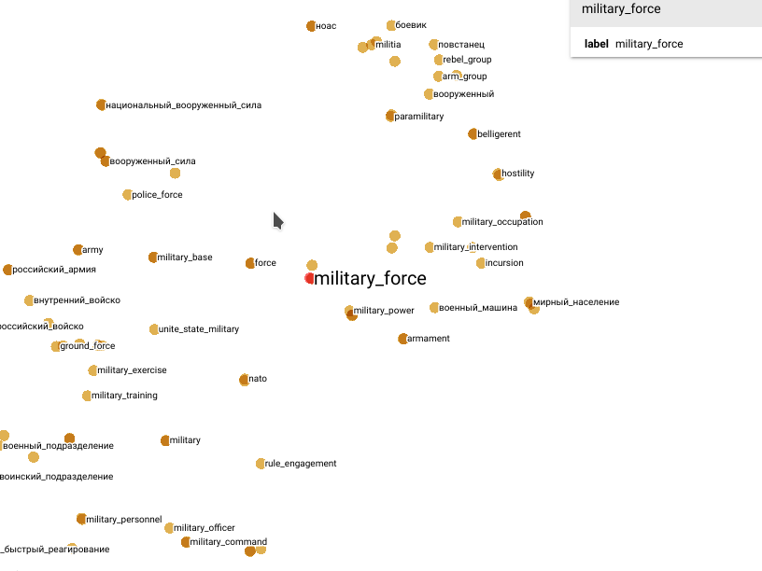

Slide 23
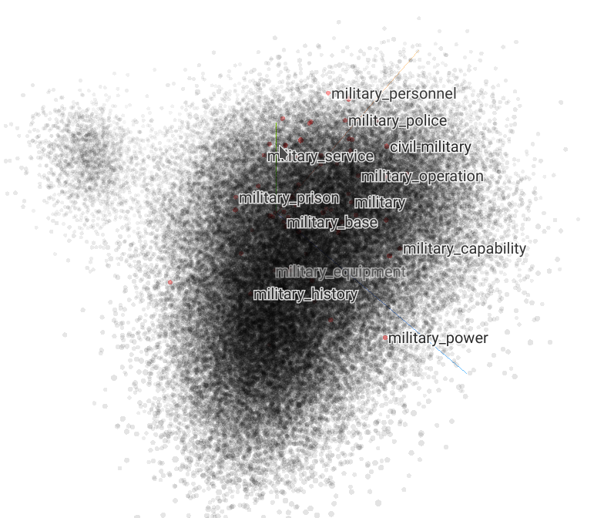
Cross-language word embeddings: Tensorboard

Slide 24
Source retrieval
Words are weighted (TF-IDF)
Only top 40-70 words are used
Map Russian words to English words via embeddings (1 ru word -> 2 en words)
Employ Vector Space Model and Hamming distance
The 100 most similar documents are retrieved on this stage

Slide 25
Source retrieval: evaluation
Dataset: English and Russian Wikipedia
Gold data: Wikipedia articles with interlanguage links (10k)
Task: Search for a given Russian article equivalent English article among all articles
Recall: 0.87

Slide 26
Source retrieval: the average recall curve per rank level

