Slide 1
Ru-Eval-2019: Evaluating anaphora and coreference resolution for Russian
E. Budnikov (ABBYY)
D. Zvereva (MIPT)
D. Maksimova, S. Toldova (NRU HSE)
M. Ionov (Goethe University Frankfurt)

Slide 2
Plan
Task definition
Corpus characteristics
Tagging strategy
Results and Future plans

Slide 3
Task definition
Coreference resolution is the task of determining which mentions in a text refer to the same entity.
Mention is a phase referring to an object or an event.
Entity is such object or event.
Example:
Paul looks at the building. He doesn’t like it.
Notes:
Решением задачи является нахождение всех кореферентных упоминаний и отнесение их к правильным классам. Упоминания, ссылающиеся на одну сущность, должны попасть в один кластер, а упоминания, ссылающиеся на разные сущности, должны попасть в разные кластеры.
3

Slide 4
Existing corpora
Message Understanding Conference-6 [Grishman, Sundheim 1996]
English (318 texts)
CoNLL-2012 Shared Task [Pradhan et al. 2012]
English (2384 texts), Arab (447), Chinese (1729)
Prague Dependency Treebank [Nedoluzhko 2016]
English, Czech (50k sentences, >60k links)
RuCor [Toldova et al. 2014]
Russian (181 texts)

Slide 5
New corpus
Source: Open Corpus of Russian Language (OpenCorpora.org)
Source size: 3729 texts
Tagged subset: 525 texts, 5.7k chains with 25k mentions

Slide 6
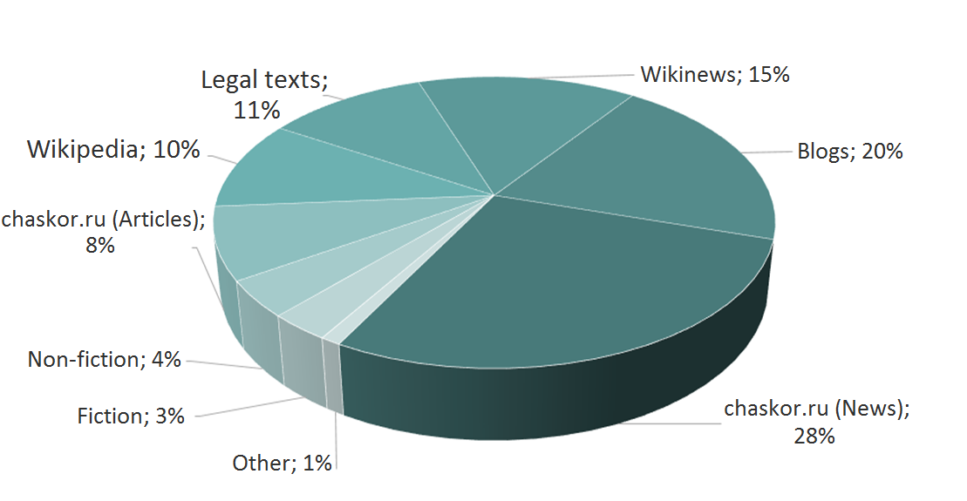
New corpus distribution

Slide 7
New corpus details
Mentions layer
Coreference chains layer
Morphological layer
Semantic-syntactic layer
Semantic classes embeddings

Slide 8
Mentions layer
Source:
ABBYY Compreno (auto)
Human annotators (manual)
Format:
Mention ID
Mention offset
Mention length

Slide 9
Mentions layer
What is mention:
Persons, Locations, Organizations, other named entities
Key word + Identifier. Always has a referent
Noun phrases
Real objects or abstract concepts that are referred to further in the text
Pronouns and pronoun phrases
All that can have a referent (except negative, reflexive, and reciprocal ones)

Slide 10
Mentions layer: interesting cases
Reflexive and reciprocal pronouns
Вася сходил в магазин. Мальчик купил *себе утюг.
Коля и Катя во всем *друг друга поддерживают.
Synonymous names (pseudonyms)
107-мм пушка образца 1940 года (М-60)
Adjectives with referents
Британская разведка; Североамериканская литература; мой дом; который смог
Notes:
Возвратные и взаимные местоимения — не размечаем (их мы и так умеем размечать)
Псевдонимы и синонимы — размечаем (хотя кажется, что это ещё про какую-то систему знаний/онтологию и/или синтаксис)
Референтные прилагательные — размечаем
NB: это прилагательные с точки зрения синтаксиса, хотя “мой” — притяжательное, а “который” — относительное местоимение

Slide 11
Mentions layer: interesting cases[2]
Named mentions vs. Unnamed mentions
Маленький мальчик Вася, который умеет плавать (2 mentions)
Маленький мальчик, который умеет плавать (1 mention)
Descriptive noun phrases
Вася признан самым смелым мальчиком в классе. Самый смелый мальчик на прошлой неделе снял котенка с дерева.
Descriptive noun phrases [2]
Лидером мнений на этой неделе оказался Петя. На прошлой неделе им был Вася.

Slide 12
Coreference chains layer
Source:
Human annotators (manual)
Format:
Mention ID
Mention offset
Mention length
Chain ID

Slide 13
Coreference chains layer: interesting cases
Part vs Whole
Петя₁ и Вася₂ одноклассники. Они₃ каждый день ходят в школу вместе. Мальчики₃ живут в соседних подъездах. Петя₁ живет на третьем этаже, а Вася₂ на пятом.
Descriptive noun phrases
Лидером мнений₁ на этой неделе оказался Петя. На прошлой неделе им₁ был Вася.

Slide 14
Morphological layer
Source:
OpenCorpora (manual)
Format:
Token ID
Token offset; Token length
Token text
Lemma
Morph Tags

Slide 15
Semantic-syntactic layer
Source:
ABBYY Compreno (auto)
Format:
Token offset; Token text
Parent token offset
Lemma
Lexical class; Semantic class
Surface Slot; Semantic Slot
Syntactic Paradigm

Slide 16
Semantic classes embeddings
Source:
ABBYY Compreno (trained on 800М words)
Format:
Semantic class ID
Vector of length 200

Slide 17
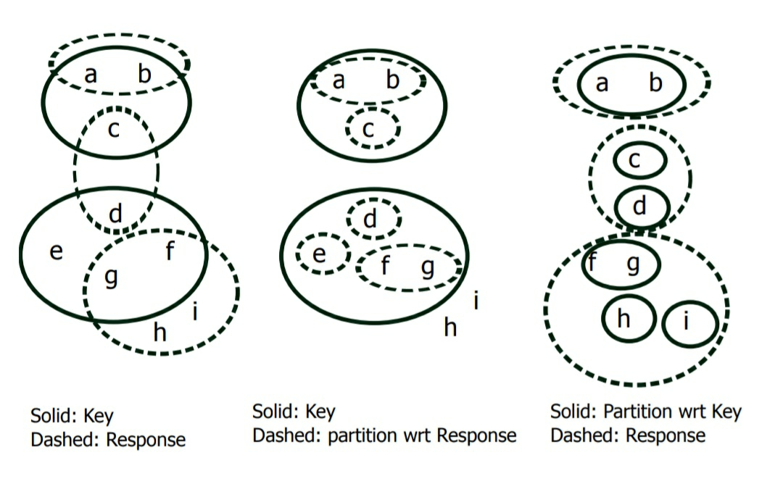
Measures
Anaphora:
F-measure
Coreference:
MUC
B-CUBE
CEAF-E

Slide 18
Coreference track results
Team | muc | bcube | ceafe | mean
legacy | 75.83 | 66.16 | 64.84 | 68.94
SagTeam | 62.23 | 52.79 | 52.29 | 55.77
DP | 62.06 | 53.54 | 51.46 | 55.68
DP (additionally trained on RuCor) | 82.62 | 73.95 | 72.14 | 76.24
Julia Serebrennikova | 48.07 | 34.7 | 38.48 | 40.42
MorphoBabushka | 61.36 | 53.39 | 51.95 | 55.57

Slide 19
Anaphora track results
Team | Run | Acc | Prec | Rec | F1 | Acc | Prec | Rec | F1
 |  | soft |  |  |  | strong
DP | Full | 76.30% | 79.20% | 76.30% | 77.80% | 68.10% | 70.70% | 68.10% | 69.40%
 | On gold | 91.00% | 91.40% | 91.00% | 91.20% | 83.50% | 83.90% | 83.50% | 83.70%
Etap |  | 52.40% | 78.70% | 52.40% | 62.90% | 39.10% | 58.70% | 39.10% | 46.90%
Legacy |  | 70.80% | 75.70% | 70.80% | 73.20% | 59.10% | 63.10% | 59.10% | 61.00%
NSU_ai |  | 23.20% | 43.30% | 23.20% | 30.20% | 6.90% | 12.90% | 6.90% | 9.00%
Morphobabushka | best-muc-1 | 62.90% | 63.50% | 62.90% | 63.20% | 38.80% | 39.10% | 38.80% | 39.00%
 | best_b3f1_and_ ceafe_4 | 55.10% | 57.30% | 55.10% | 56.20% | 37.10% | 38.60% | 37.10% | 37.80%
 | best_b3f1_and_ ceafe_5 | 54.50% | 59.40% | 54.50% | 56.80% | 35.10% | 38.30% | 35.10% | 36.60%
Meanotek |  | 44.40% | 58.70% | 44.40% | 50.60% | 34.70% | 45.80% | 34.70% | 39.40%
 |  | 52.40% | 78.70% | 52.40% | 62.90% | 39.20% | 58.80% | 39.20% | 47.00%

Slide 20
References
Anisimovich K., Druzhkin K., Minlos F., Petrova M., Selegey V., and Zuev K. (2012), Syntactic and semantic parser based on ABBYY Compreno linguistic technologies. In Computational Linguistics and Intellectual Technologies. Papers from the Annual International Conference ”Dialogue”, vol. 11, pp. 91– 103.
Bagga, A., & Baldwin, B. (1998, August). Entity-based cross-document coreferencing using the vector space model. In Proceedings of the 17th international conference on Computational linguistics-Volume 1(pp. 79-85). Association for Computational Linguistics.
Bogdanov, A., Dzhumaev, S., Skorinkin, D., & Starostin, A. (2014). Anaphora analysis based on ABBYY Compreno linguistic technologies. Computational Linguistics and Intellectual Technologies, 13(20), 89-101.
Cai, J., & Strube, M. (2010, September). Evaluation metrics for end-to-end coreference resolution systems. In Proceedings of the 11th Annual Meeting of the Special Interest Group on Discourse and Dialogue (pp. 28-36). Association for Computational Linguistics.
Grishina, Y., 2017. CORBON 2017 Shared Task: Projection-Based Coreference Resolution. In Proceedings of the 2nd Workshop on Coreference Resolution Beyond OntoNotes (CORBON 2017) (pp. 51-55).
Grishman, R., & Sundheim, B. (1996). Message understanding conference-6: A brief history. In COLING 1996 Volume 1: The 16th International Conference on Computational Linguistics (Vol. 1).
Khadzhiiskaia, A., Sysoev, A. (2017). Coreference resolution for Russian: taking stock and moving forward. In 2017 Ivannikov ISPRAS Open Conference (ISPRAS), pp. 70-75. IEEE, 2017.
Lee, K., He, L., Lewis, M., & Zettlemoyer, L. (2017). End-to-end Neural Coreference Resolution. arXiv preprint arXiv:1707.07045.
Luo, X. (2005, October). On coreference resolution performance metrics. In Proceedings of the conference on Human Language Technology and Empirical Methods in Natural Language Processing (pp. 25-32). Association for Computational Linguistics.
Clark, K., & Manning, C. D. (2015, July). Entity-Centric Coreference Resolution with Model Stacking. In ACL (1) (pp. 1405-1415).
Martschat, S., & Strube, M. (2015). Latent structures for coreference resolution. Transactions of the Association for Computational Linguistics, 3, 405-418.
Moosavi, N. S., & Strube, M. (2016). Which Coreference Evaluation Metric Do You Trust? A Proposal for a Link-based Entity Aware Metric. In ACL (1)
Ngụy Giang Linh, Michal Novak, Anna Nedoluzhko (2016). Coreference Resolution in the Prague Dependency Treebank. (ÚFAL/CKL Technical Report #TR-2011-43). Prague: Universitas Carolina Pragensis.
Ogrodniczuk, M., Głowińska, K., Kopeć, M., Savary, A. and Zawisławska, M., 2013, December. Polish coreference corpus. In Language and Technology Conference (pp. 215-226). Springer, Cham.
Poesio, M., Ng, V. and Ogrodniczuk, M., 2018. Proceedings of the First Workshop on Computational Models of Reference, Anaphora and Coreference. In Proceedings of the First Workshop on Computational Models of Reference, Anaphora and Coreference.
Pradhan, S., Moschitti, A., Xue, N., Uryupina, O., & Zhang, Y. (2012, July). CoNLL-2012 shared task: Modeling multilingual unrestricted coreference in OntoNotes. In Joint Conference on EMNLP and CoNLL-Shared Task (pp. 1-40). Association for Computational Linguistics.
Soraluze, A., Arregi, O., Arregi, X. and de Ilarraza, A.D., 2015. Coreference Resolution for Morphologically Rich Languages. Adaptation of the Stanford System to Basque. Procesamiento del Lenguaje Natural, 55, pp.23-30.
Stepanova M. E., Budnikov E. A., Chelombeeva A. N., Matavina P. V., Skorinkin D. A. (2016),Information Extraction Based on Deep Syntactic-Semantic Analysis. In Computational Linguistics and Intellectual Technologies. Papers from the Annual International Conference ”Dialogue”, pp. 721-732.
Toldova, S., Roytberg, A., Ladygina, A., Vasilyeva, M., Azerkovich, I., Kurzukov, M., ... & Grishina, Y. (2014). RU-EVAL-2014: Evaluating anaphora and coreference resolution for Russian. Computational Linguistics and Intellectual Technologies, 13(20), 681-694.
Toldova, S. and Ionov, M., 2017. Coreference resolution for russian: the impact of semantic features. In Proceedings of International Conference Dialogue-2017 (pp. 348-357).
Vilain, M., Burger, J., Aberdeen, J., Connolly, D., & Hirschman, L. (1995, November). A model-theoretic coreference scoring scheme. In Proceedings of the 6th conference on Message understanding (pp. 45-52). Association for Computational Linguistics.

Slide 21
THANK YOU
21

