Slide 1
DICTIONARY AGGREGATOR VYSHKA.DICTIONARIES
Speakers:
Sergey Mikhaylov
Daria Shershneva

Slide 2
Key concepts
unique dictionary resource based on data crowdsourcing
rich search functionality useful for broad audience
user-friendly interface

Slide 3
Crowdsourcing of dictionaries
unified template for all dictionaries based on TEI structure
users upload their dictionaries through personal account. Two stages of validation: technical verification of tag structure and expert examination
after successful validation administrators add a new dictionary to the database

Slide 4
Search functionality
Two types of search:
search by word → getting all available information from the database
advanced search → finding words corresponding to the specific query
Results of an advanced search could be downloaded as csv-file

Slide 5
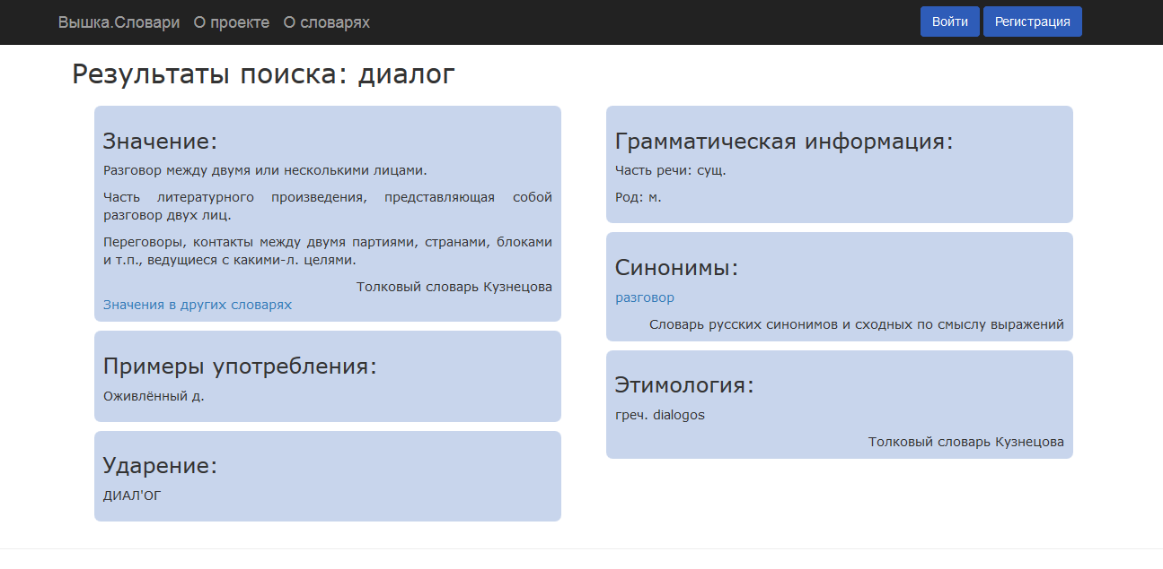

Slide 6
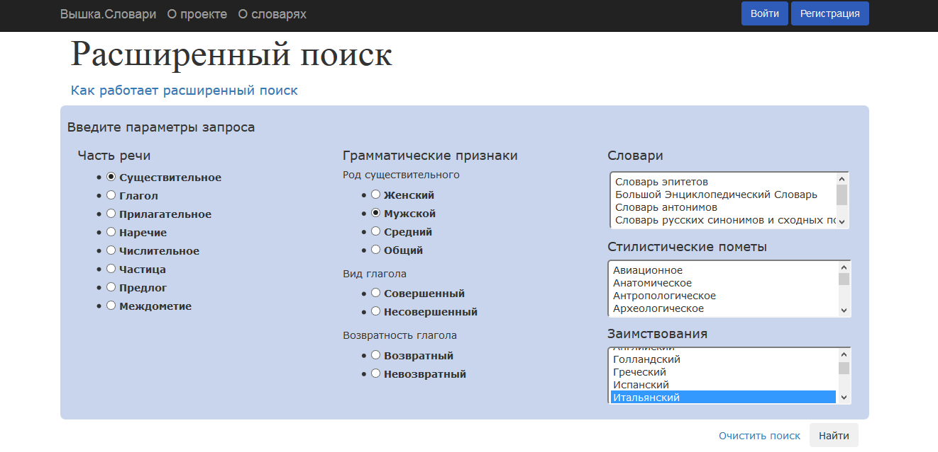

Slide 7
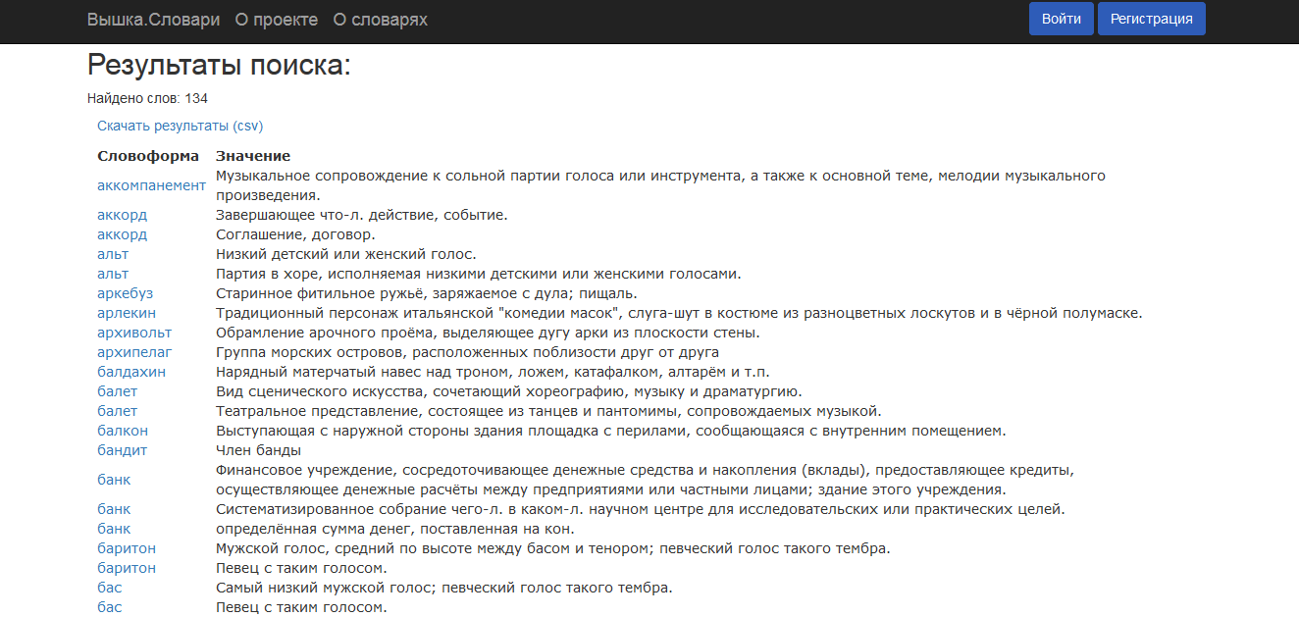

Slide 8
Technical and statistical details
Dictionaries: 5 (Kuznetsov Dictionary, The Great Encyclopedic Dictionary, Dahl Dictionary, Abramov Synonyms Dictionary, Lvov Antonyms Dictionary)
Number of entries: 325 783
Site architecture ← framework Flask
Database ← MySQL

Slide 9
References
Vyshka.Dictionaries on GitHub: https://github.com/Dashershneva/Slovari
http://linghub.ru/hse.slovari/

