Slide 1
The cues for rhetorical relations in Russian: "Cause-Effect" relation in Russian Rhetorical Structure Treebank
Toldova S., Pisarevskaya D., Kobozeva M., Vasilyeva M.

Slide 2
bACKGROUND

Slide 3
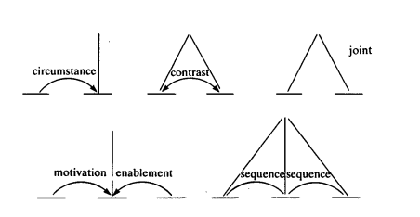
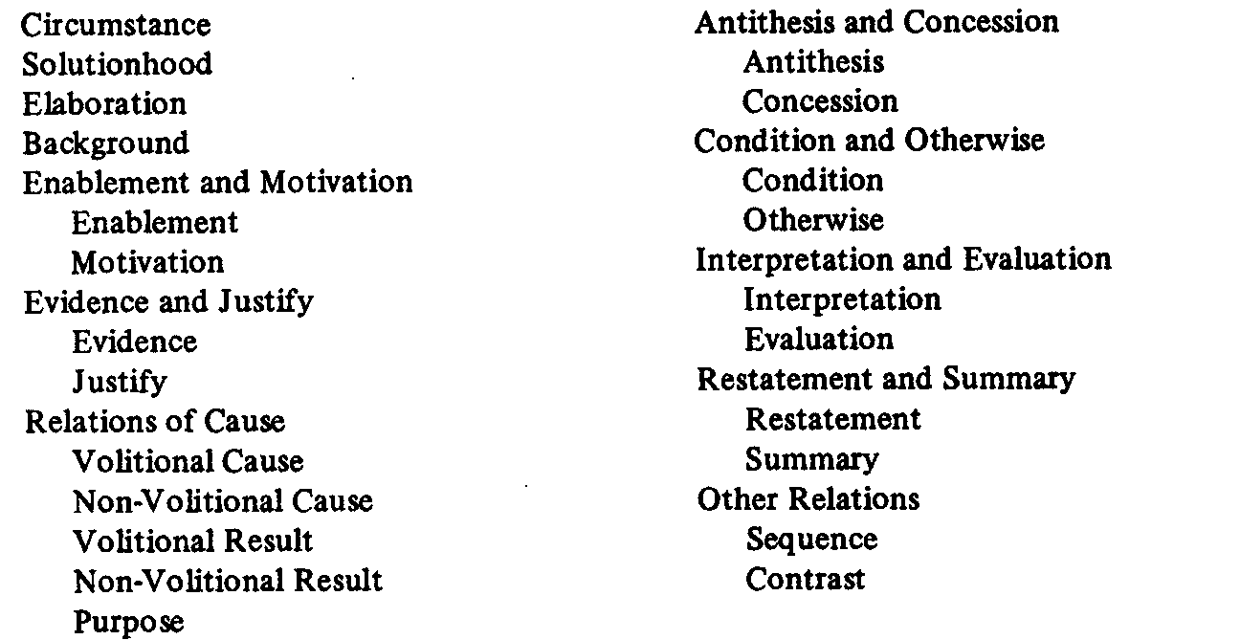
RHETORICAL STRUCTURE THEORY
Text as a hierarchy of elementary discourse units (EDUs) [Mann, Thompson, 1988] .
Some EDUs carry more important information (nucleus) than others (satellite).
Examples of schema types ‘Classic’ relations set

Slide 4
OUR CORPUS: The RU-RSTreebank [Pisarevskaya et al. 2017]
texts are available online: http://linghub.ru/ru-rstreebank/
79 texts, 5582 EDUs and 49840 tokens
news, news analytics and popular science
EDU: finite clauses, prepositional phrases, adverbial phrases headed by corresponding connectives (cf. because of, in spite of)

Slide 5
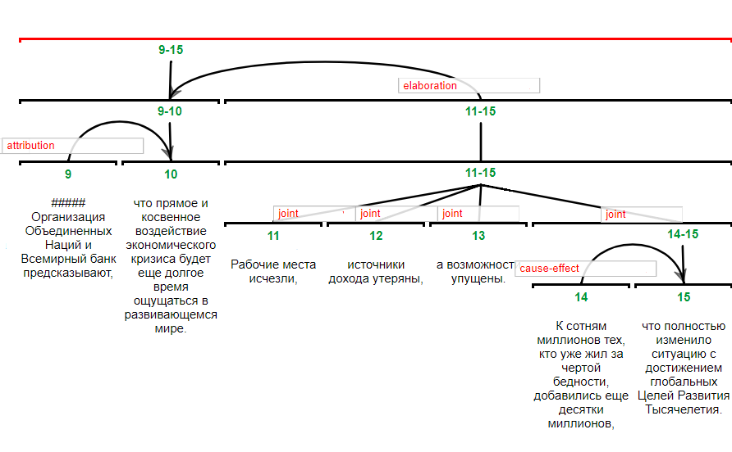
ANNOTATION SAMPLE

Slide 6
CAUSE-EFFECT RELATION EXAMPLE
[Apple ещё не начала официальные продажи в нашей стране.] _{satellite}
[Поэтому отчаянные потребители везут планшеты из США сами.] _{nucleus}
[Apple has not yet begun official sales in our country.]
[Therefore, desperate consumers are carrying tablets from the US themselves]
How the Cause-Effect relations can be signalled?

Slide 7
DISCOURSE CONNECTIVES LEXICONS
Different approaches:
manually, using standard dictionaries and grammars
German, English [Stede, Umbach 1998]
Spanish [Alonso et al. 2002]
French [Roze et al. 2012]
2. by extracting connectives from available corpora
Arabic lexicon [Al-Saif et al. 2010]
3. by translating connectives from source into the target language
[Meyer, Webber 2013]

Slide 8
DISCOURSE CONNECTIVES LEXICONS
Annotation features for connectives:
Syntactic (part-of-speech, linear ordering of the conjuncts, position within a text span etc.)
Semantic (semantic relations, polarity, functional ordering of spans)
Pragmatic (discourse relation, presupposition, stylistic features)
Contextual (occurrence in initial/final segment, previous/following word, level of embedding etc.)
[Grote, Stede 1998], [Alonso et al. 2002]

Slide 9
THE TYPOLOGY OF CAUSAL RELATIONS SIGNALS
causal connectives linking two phrases, clauses or sentences (adverbial, prepositional, clause-integrated connectives)
causative verbs - transitive verbs that specify the result of an action, event or state, or the influence of some object
resultative constructions
conditional constructions
causative adverbs and adjectives
[Khoo 1998], [Chang, Choi 2006 ], [Asghar 2016],

Slide 10
DATA

Slide 11
Data
Causal relations in the Ru-RSTreebank
220 examples for the Cause-Effect and 110 for the Evidence relation
intra- and inter-sentential relations

Slide 12
The list of connectives
Primary connectives
Secondary connectives
“mainly grammatical (or functional) words which primary function is to connect two units of a text” [Rysová M., Rysová K. 2014]
The source: Russian grammar [Shvedova ed. 1980]
из-за ‘because of’
поэтому ‘therefore’
в связи с ‘in connection with’
not yet grammaticalized; a heterogeneous and open-ended class of elements
Alternative Lexicalization in the Penn Discourse Treebank [Prasad et al. 2010]
46,5% of our examples.
это привело к тому, что ‘this led to the fact that’
причина этого ‘the cause is’
это стало результатом ‘this became a result’

Slide 14
The scheme for connectives annotation
Discourse connectives:
They are two-arguments predicates
Their arguments are discourse units
[Apple ещё не начала официальные продажи в нашей стране.] _{satellite}
[Поэтому отчаянные потребители везут планшеты из США сами.] _{nucleus}
[Apple has not yet begun official sales in our country.]
[Therefore, desperate consumers are carrying tablets from the US themselves]

Slide 15
The scheme for connectives annotation
Type of connective (primary/secondary/NA)
Simple or complex structure (one-/multi-word)
Core word in a connective (POS)
что приводит к тому, что ‘that leads to…’
Secondary
MWU
verb

Slide 16
The scheme for connectives annotation
Listed in the RNC MWU lists
A causal conjunction listed in RusGram
что приводит к тому, что ‘that leads to…’
no
no

Slide 17
The scheme for connectives annotation
Position of a connective within EDU (clause initial/clause internal)
Position of a connective within a sentence (sentence initial/no)
Position of a connective in nucleus vs. satellite (nucleus/satellite)
Connection type wrt sentential boundaries (intra-/inter-sentential)
что приводит к тому, что ‘that leads to…’
Clause initial
No
Satellite
Intra-sentential

Slide 18
The scheme for connectives annotation
Order of Nucleus (wrt. Satellite)
Nucleus/ Satellite complexity (span, sentence, multiclause, clause)
Number of clauses in the Nucleus/Satellite
Gram. features of the Nucleus/ Satellite head (indicative/converb/participle/nominalization/noun)
Anaphoric element in the Nucleus/Satellite (this/that/what/nd)
что приводит к тому, что ‘that leads to…’
satellite-nucleus
clause/clause
1/1
indicative/indicative
what/nd

Slide 19
Properties of Causal connectives

Slide 20
Patterns for Secondary causal Discourse Connectives
Constructions containing causative (and some other) verbs
Light verbs constructions
Complex prepositions
Adverbials
Adverbs
Other constructions with nouns

Slide 21
Patterns for Secondary causal Discourse Connectives
(1) Constructions containing
causative causation veverbs (X вызывает Y ‘X produce Y’),
verbs of mental impact (X можно объяснить Y-ом ‘one can justify Х via Y’)
motion causation verbs (X приводит к Y ‘to bring about’),
change of state rbs (X изменяет Y ‘X causes the change in Y’)
[Неудачно остановившаяся машина стала помехой для быстрых кругов многих гонщиков]_{satellite} [и это вызвало расследование FIA.]_{nucleus}
‘The poorly stopped car became a hindrance to the fast laps of many racers and this evoked an investigation by the FIA.’

Slide 22
Patterns for Secondary causal Discourse Connectives
(2) Light verbs constructions: a content noun denoting ‘cause’ or ‘effect’ and a light verb (являться ‘to be’, становиться ‘to become’ etc.)
(3) Complex prepositions: a preposition and a content noun (в результате X ‘as a result’, вследствие X ‘in consequence of’, в отместку за X ‘in revenge’)
[... повышение цен стало результатом]_{nucleus} [удорожания сырья.] _{satellite}
‘... the price increase was the result of the rise in price of raw materials.’
[Неприличным был объявлен текст песни «Ich tu dir weh»,]_{satellite} [в результате чего композицию запретили для исполнения на публике.]_{nucleus}
‘The lyrics of the song … were declared indecent, as a result of which the composition was banned for performance in public.’

Slide 23
Patterns for Secondary causal Discourse Connectives
(4) Adverbials: adverbial phrases and converbs (X связан c Y ‘concerned with’, X обусловлен Y ‘caused by’, учитывая X ‘taking into account’)
(5) Adverbs: (и) поэтому+CP ‘(and) therefore’, не случайно+CP ‘not accidentally’.
[Предполагают, что синий цвет внешнего кольца обусловлен тем,]_{nucleus} [что оно в дополнении к пыли обладает некоторой примесью мелких частиц водяного льда с поверхности Маба.] _{satellite}
‘…the blue color of the outer ring is due to the fact that …it has some admixture of small particles of water ice from the surface of the Mab.’

Slide 24
Patterns for Secondary causal Discourse Connectives
(6) Other constructions with nouns X одна из основ Y ‘one of the bases’, причина ADJ: ‘a cause is ADJ’
[Нынешний норматив - 75% - был введен законом с подачи ЦБ вскоре после "великого дефолта".]_{nucleus} [Причина простая: финансовый кризис лишил его валютных резервов.] _{satellite}
‘Current norm – 75% was established by the law at the CB behest soon after the “great default”. The reason (for that) is simple: the financial crisis deprived him of foreign exchange reserves.’

Slide 25
Anaphoric Elements in Multi-Word Connectives
Example: благодаря X ‘thanks to X’. X can be:
a Noun Phrase
the demonstrative это (этот) ‘this’
the relative pronoun что ‘what’
[Благодаря физиологической адаптации]_{satellite} [человек может приспосабливаться к значительным изменениям погоды.] _{nucleus}
‘Thanks to physiological adaptation, a man can adapt to significant weather changes’.
[Человек адаптируется к разным условиям.]_{satellite} [Благодаря этому он может …]_{nucleus}
‘A man adapts to different conditions. Thanks to this he can…’
[Человек адаптируется …,]_{satellite} [благодаря чему он может…]_{nucleus}
‘A man adapts …, thanks to which he can…’

Slide 26
Anaphoric Elements in Multi-Word Connectives
Different degree of grammaticalization:
благодаря этому ‘thanks to this’
благодаря чему ‘thanks to which’
благодаря + NP ‘thanks to + NP’
благодаря тому что ‘thanks to the fact that’

Slide 27
Comparison of Primary and Secondary Connectives
Difference in the position of two types of connectives with respect to the satellite vs. nucleus opposition (a cause is a satellite and an effect is a nucleus in ‘Cause-Effect’ relation). Primary connectives are located in an effect-span more frequently than secondary ones.

Slide 28
Comparison of Primary and Secondary Connectives
The order of EDU differs, depending on the class of the connective used to signal the relation between EDUs. The preferable order is “nucleus-satellite” for relations marked with primary connectives and the satellite precedence is preferable with secondary ones.

Slide 29
Comparison of Primary and Secondary Connectives
The primary connectives signal inter-clausal relations within a sentence more frequently than secondary ones, while the latter are used to mark inter-sentential relations or they are used for intra-clausal relations when discourse units are expressed via nominalizations.
There is no statistically significant difference between spans size with secondary and primary markers.

Slide 30
Conclusion and next steps
Discourse connectives are reliable signals for different types of relations.
We suggest the list of causal relation connectives based on Ru-RSTreebank, schemes for connectives annotation in the corpus and in the lexicon.
We can expand the lexicon via mining new items (not listed in grammars and dictionaries) from a large corpus on the basis of a seed set of connectors extracted manually from the Ru-RSTreebank. We can extract patterns for non-grammaticalized connectives from the annotated RST corpus.

Slide 31
Conclusion and next steps
Basic patterns:
n-gram + то, что : по причине того, что ‘by reason that’
<s> n-gram: includes это ‘this’ – по причине этого ‘by this reason’, в результате этого ‘as a result of this’, приводит к тому, что ‘lead to the fact that’
, n-gram + что: в результате чего ‘lit. as the result of what’, что является причиной ‘that is the cause’

Slide 32
references
Al-Saif A., Markert K. (2010), The Leeds Arabic Discourse Treebank: Annotating Discourse Connectives for Arabic. In LREC 2010 Proceedings, pp. 2046-2053.
Alonso L., Castellón I., Gibert K., Padró L. (2002), An empirical approach to discourse markers by clustering. In Topics in Artificial Intelligence, Springer, Berlin, Heidelberg, pp. 173-183.
Apresyan YU. D. (2001), System-forming meanings ‘to know’ and ’to consider’ in Russian [Sistemoobrazuyushchiye smysly «znat'» i «schitat'» v russkom yazyke], Russian Language and Linguistic Theory [Russkiy yazyk v nauchnom osveshchenii], 1, pp. 5-26.
Asghar N. (2016), Automatic Extraction of Causal Relations from Natural Language Texts: A Comprehensive Survey, arXiv preprint arXiv:1605.07895.
Boguslavskaya, O. YU., Levontina, I. B. (2004). Meanings ‘cause’ and ‘purpose’ in natural language [Smysly 'prichina' i 'tsel' v yestestvennom yazyke], Topics in the study of language [Voprosy yazykoznaniya], (2), pp. 68-88.
Carlson L., Marcu D. (2001), Discourse tagging reference manual. ISI Technical Report ISI-TR-545, 54, 56.
Chafe, W. (1994), Discourse, consciousness, and time: The flow and displacement of conscious experience in speaking and writing, University of Chicago Press.
Chang D. S., Choi K. S. (2006), Incremental cue phrase learning and bootstrapping method for causality extraction using cue phrase and word pair probabilities , Information processing & management, Vol. 42, №. 3, pp. 662-678.
Ferrucci, D., Brown, E., Chu-Carroll, J., Fan, J., Gondek, D., Kalyanpur, A. A., ... & Schlaefer, N. (2010), Building Watson: An overview of the DeepQA project. AI magazine, 31(3), 59-79.
Galitsky B., Ilvovsky D. and Kuznetsov S.O. (2018), Detecting Logical Argumentation in Text via Communicative Discourse Tree. To appear in Journal of Experimental and Theoretical Artificial Intelligence. JETAI 2018.
Glovinskaya, M. Y. (1993), Russian Speech Acts with the Meaning of Mental Pressure./ Logical analysis of language. Mental actions. Moscow: Science. [Russkie rechevihe akty so znacheniem mentaljnogo vozdeyjstviya / Logicheskiyj analiz yazihka. Mentaljnihe deyjstviya.]

Slide 33
references
Grote B., Stede M. (1998), Discourse marker choice in sentence planning, Proceedings of the 9th International Workshop on Natural Language Generation, Niagara-on-the-Lake, Canada, August 1998.
Hirschberg, J., Litman, D. (1993), Empirical studies on the disambiguation of cue phrases, Computational linguistics, 19(3), pp. 501-530.
Khoo C. S. G. et al. (1998), Automatic extraction of cause-effect information from newspaper text without knowledge-based inferencing, /Literary and Linguistic Computing, Vol. 13, №. 4. pp. 177-186.
Kibrik, A. A., Podlesskaya, V. I. (2003), Towards building corpora of oral Russian speech: principles of transcription [K sozdaniyu korpusov ustnoy russkoy rechi: printsipy transkribirovaniya], Scientific and Technical Information Processing (series 2) Nauchno-tekhnicheskaya informatsiya (seriya 2), 6, pp. 5-11.
Knott A. (1996), A data-driven methodology for motivating a set of coherence relations, Thesis (doctoral), University of Edinburgh.
Kustova, G. I. (2017), The Types of Adverbials [Tipy konstruktsiy s adverbialami], Computational Linguistics and Intellectual Technologies: Proc. of the Int. Conf." Dialogue, Vol. 2, pp.234-249.
Lee, A., Prasad, R., Webber, B., & Joshi, A. K. (2016), Annotating Discourse Relations with The PDTB Annotator. In Proceedings of COLING 2016, the 26th International Conference on Computational Linguistics: System Demonstrations, pp. 121-125).
Louis, A., Joshi, A., & Nenkova, A. (2010), Discourse indicators for content selection in summarization. In Proceedings of the 11th Annual Meeting of the Special Interest Group on Discourse and Dialogue (pp. 147-156), Association for Computational Linguistics.
Mann W. C., Thompson S. A. (1988), Rhetorical Structure Theory: Toward a Functional Theory of Text Organization, Text 8, 3, pp. 243–281.
Meyer T., Webber B. Implicitation of discourse connectives in (machine) translation (2013), Proceedings of the Workshop on Discourse in Machine Translation, pp. 19-26.
Mírovský, J., Synková, P., Rysová, M., & Poláková, L. (2017), CzeDLex–A Lexicon of Czech Discourse Connectives. The Prague Bulletin of Mathematical Linguistics, 109(1), pp. 61‑91.
Paducheva, E.V. (2004), Dynamic models in the semantics of vocabulary [Dynamicheskiye modeli v yazyke]. M.: Languages of Slavonic Culture.

Slide 34
references
Pekelis, O. Ye. (2014), Causal subordinate clauses [Prichinnyye pridatochnyye], Materials for the project of Russian grammar corpus description [Materialy dlya proyekta korpusnogo opisaniya russkoy grammatiki], avaliable at: http://rusgram.ru. As a manuscript [Na pravakh rukopisi], M, 2015.
Pisarevskaya D. et al. (2017), Towards building a discourse-annotated corpus of Russian, Computational Linguistics and Intellectual Technologies: Proc. of the Int. Conf." Dialogue, Vol. 1, pp. 194‑204.
Prasad R. et al. (2007), The penn discourse treebank 2.0 annotation manual.
Prasad R., Joshi A., Webber B. (2010), Realization of discourse relations by other means: alternative lexicalizations, Proceedings of the 23rd International Conference on Computational Linguistics: Posters, Association for Computational Linguistics, pp. 1023‑1031.
Roze C., Danlos L., Muller P. (2012), LEXCONN: a French lexicon of discourse connectives, Discours. Revue de linguistique, psycholinguistique et informatique. A journal of linguistics, psycholinguistics and computational linguistics, №. 10.
Rysová M., Rysova K. (2014), The Centre and Periphery of Discourse Connectives, PACLIC, pp. 452-459.
Schauer H. (2000), From elementary discourse units to complex ones, Proceedings of the 1st SIGdial workshop on Discourse and dialogue-Volume 10, Association for Computational Linguistics, pp. 46-55.
Shvedova, N. YU. ed. (1980), Russian grammar [Russkaya grammatika]. V dvukh tomakh. AN SSSR Institut russkogo jazyka. — M.: Nauka, 1980.
Stede M., Umbach C. (1998), DiMLex: A lexicon of discourse markers for text generation and understanding, Proceedings of the 17th international conference on Computational linguistics-Volume 2, Association for Computational Linguistics, pp. 1238-1242.
Taboada, M., Voll, K., & Brooke, J. (2008), Extracting sentiment as a function of discourse structure and topicality. Simon Fraser Univeristy School of Computing Science Technical Report.
Toldova S. et al. (2017), Rhetorical relation markers in Russian RST Treebank, Proceedings of the 6th Workshop Recent Advances in RST and Related Formalisms, Santiago de Compostela, Spain, September 4 2017, Association for Computational Linguistics, pp. 29−33.

Slide 35
Thank you for attention!

